Slide 1

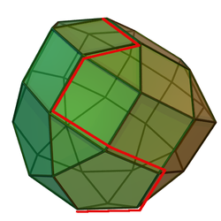
Game Theory
[Continued]
[Continued]
From
Mathematical Optimization and Economic Theory
Jacob Wyngaard

Slide 2
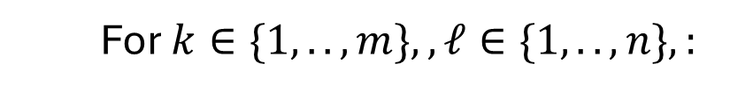
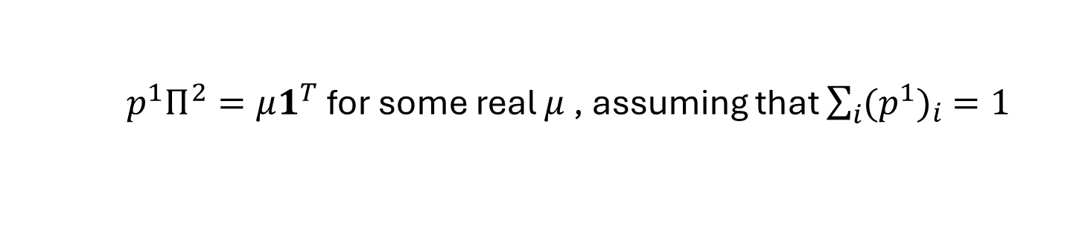
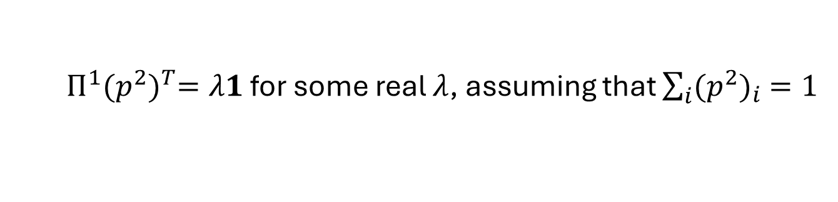
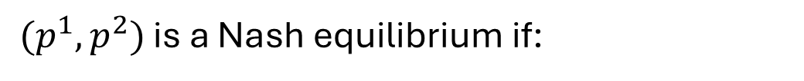
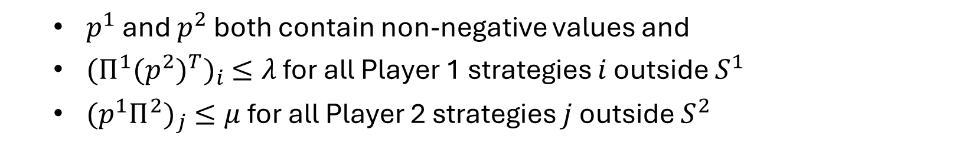
Support Enumeration Review
Nashpy has a Support Enumeration method for finding equilibria
For $k∈\{1, ..,m\},,ℓ∈\{1, ..,n\},:$
For all possible ways to select $k$ strategies for Player 1 and $ℓ$ strategies for Player 2:
[these correspond to the supports $S^{1}$ and $S^{2}$]
Solve the indifference equations:
$Π^{1}{(p^{2})}^{T}=λ1$ for some real $λ$, assuming that $\sum_{i}{{(p^{2})}_{i} =1}$
$p^{1}Π^{2}=μ1^{T}$ for some real $μ$ , assuming that $\sum_{i}{{(p^{1})}_{i} =1}$
[where $p^{1},p^{2},$ $Π^{1}$, and $Π^{2}$ are projections of the probability vectors and payoff matrices onto $S^{1}$ and $S^{2}$]
$(p^{1},p^{2})$ is a Nash equilibrium if:
$p^{1}$ and $p^{2}$ both contain non-negative values and
${(Π^{1}{(p^{2})}^{T})}_{i} ≤λ$ for all Player 1 strategies $i$ outside $S^{1}$
${(p^{1}Π^{2})}_{j} ≤μ$ for all Player 2 strategies $j$ outside $S^{2}$

Slide 3
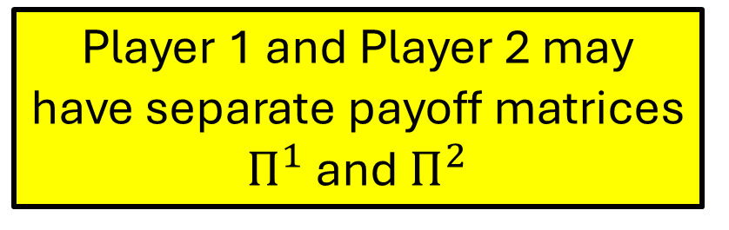
Support Enumeration Review
Nashpy has a Support Enumeration method for finding equilibria
For $k∈\{1, ..,m\},,ℓ∈\{1, ..,n\},:$
For all possible ways to select $k$ strategies for Player 1 and $ℓ$ strategies for Player 2:
[these correspond to the supports $S^{1}$ and $S^{2}$]
Solve the indifference equations:
$Π^{1}{(p^{2})}^{T}=λ1$ for some real $λ$, assuming that $\sum_{i}{{(p^{2})}_{i} =1}$
$p^{1}Π^{2}=μ1^{T}$ for some real $μ$ , assuming that $\sum_{i}{{(p^{1})}_{i} =1}$
Player 1 and Player 2 may have separate payoff matrices $Π^{1}$ and $Π^{2}$
[where $p^{1},p^{2},$ $Π^{1}$, and $Π^{2}$ are projections of the probability vectors and payoff matrices onto $S^{1}$ and $S^{2}$]
$(p^{1},p^{2})$ is a Nash equilibrium if:
$p^{1}$ and $p^{2}$ both contain non-negative values and
${(Π^{1}{(p^{2})}^{T})}_{i} ≤λ$ for all Player 1 strategies $i$ outside $S^{1}$
${(p^{1}Π^{2})}_{j} ≤μ$ for all Player 2 strategies $j$ outside $S^{2}$

Slide 4
Support Enumeration Review
Nashpy has a Support Enumeration method for finding equilibria
For $k∈\{1, ..,m\},,ℓ∈\{1, ..,n\},:$
For all possible ways to select $k$ strategies for Player 1 and $ℓ$ strategies for Player 2:
[these correspond to the supports $S^{1}$ and $S^{2}$]
Solve the indifference equations:
Strong Minimax Theorem: If the expectation value of a strategy (assuming the other player selects their equilibrium strategy) is below the value of their game, that strategy is chosen with probability 0
$Π^{1}{(p^{2})}^{T}=λ1$ for some real $λ$, assuming that $\sum_{i}{{(p^{2})}_{i} =1}$
$p^{1}Π^{2}=μ1^{T}$ for some real $μ$ , assuming that $\sum_{i}{{(p^{1})}_{i} =1}$
[where $p^{1},p^{2},$ $Π^{1}$, and $Π^{2}$ are projections of the probability vectors and payoff matrices onto $S^{1}$ and $S^{2}$]
$(p^{1},p^{2})$ is a Nash equilibrium if:
$p^{1}$ and $p^{2}$ both contain non-negative values and
${(Π^{1}{(p^{2})}^{T})}_{i} ≤λ$ for all Player 1 strategies $i$ outside $S^{1}$
${(p^{1}Π^{2})}_{j} ≤μ$ for all Player 2 strategies $j$ outside $S^{2}$

Slide 5

Support Enumeration Review
Nashpy has a Support Enumeration method for finding equilibria
For $k∈\{1, ..,m\},,ℓ∈\{1, ..,n\},:$
For all possible ways to select $k$ strategies for Player 1 and $ℓ$ strategies for Player 2:
[these correspond to the supports $S^{1}$ and $S^{2}$]
Solve the indifference equations:
$Π^{1}{(p^{2})}^{T}=λ1$ for some real $λ$, assuming that $\sum_{i}{{(p^{2})}_{i} =1}$
$p^{1}Π^{2}=μ1^{T}$ for some real $μ$ , assuming that $\sum_{i}{{(p^{1})}_{i} =1}$
[where $p^{1},p^{2},$ $Π^{1}$, and $Π^{2}$ are projections of the probability vectors and payoff matrices onto $S^{1}$ and $S^{2}$]
If $k= ℓ$, then solving the indifference equations correspond to solving a square system of equations
$(p^{1},p^{2})$ is a Nash equilibrium if:
$p^{1}$ and $p^{2}$ both contain non-negative values and
${(Π^{1}{(p^{2})}^{T})}_{i} ≤λ$ for all Player 1 strategies $i$ outside $S^{1}$
${(p^{1}Π^{2})}_{j} ≤μ$ for all Player 2 strategies $j$ outside $S^{2}$

Slide 6
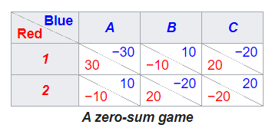


Support Enumeration with $k ≠ ℓ$
What about when $k≠ℓ$?
The Support Enumeration algorithm only lets us select supports with $k=ℓ$ !
This works so long as we have a non-degenerate two player games
A Degenerate Two Player Game
20
A degenerate game has different strategies with the same payoffs
30
1
1
-10
-1
-10
-20
2
20
7
2

Slide 7
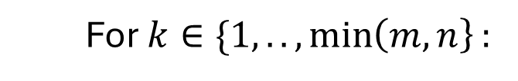
Support Enumeration (Fixed)
Nashpy has a Support Enumeration method for finding equilibria
For $k∈\{1, ..,\min\left(m,n\right\}:$
For all possible ways to select $k$ strategies for Player 1 and $k$ strategies for Player 2:
[these correspond to the supports $S^{1}$ and $S^{2}$]
Solve the indifference equations:
$Π^{1}{(p^{2})}^{T}=λ1$ for some real $λ$, assuming that $\sum_{i}{{(p^{2})}_{i} =1}$
$p^{1}Π^{2}=μ1^{T}$ for some real $μ$ , assuming that $\sum_{i}{{(p^{1})}_{i} =1}$
[where $p^{1},p^{2},$ $Π^{1}$, and $Π^{2}$ are projections of the probability vectors and payoff matrices onto $S^{1}$ and $S^{2}$]
$(p^{1},p^{2})$ is a Nash equilibrium if:
$p^{1}$ and $p^{2}$ both contain non-negative values and
${(Π^{1}{(p^{2})}^{T})}_{i} ≤λ$ for all Player 1 strategies $i$ outside $S^{1}$
${(p^{1}Π^{2})}_{j} ≤μ$ for all Player 2 strategies $j$ outside $S^{2}$

Slide 8
Support Enumeration (Example)
Consider the following zero-sum game:
Player 2
A
B
C
D
1
1 | 25 | 26 | 2
35 | 1 | 36 | 3
45 | 46 | 1 | 4
Player 1
2
3
*No strategies can be eliminated by strict dominance

Slide 9


















Support Enumeration (Example)
$$S^{1}$$
$$S^{2}$$
$$p^{1}$$
$$p^{2}$$
Positivity?
Better than strategies outside support?
1
A
$$[1,0,0]$$
$$[1,0,0,0]$$
2 performs better for Player 1
2
A
$$[0,1,0]$$
$$[1,0,0,0]$$
3 performs better for Player 1
…
…
…
…
…
…
1,2
A,B
$$[\frac{17}{29},\frac{12}{29}, 0]$$
$$[\frac{12}{29},\frac{17}{29},0,0]$$
2 performs better for Player 1
1,3
A,B
$$[\frac{−1}{23},0,\frac{24}{23}]$$
$$[\frac{−21}{23},\frac{44}{23},0,0]$$
…
…
…
…
…
…
2,3
C,D
$$[0,\frac{1}{12}, \frac{11}{12}]$$
$$[0,0,\frac{1}{36},\frac{35}{36}]$$
*This solution was validated with NashPy Vertex Enumeration
* Interestingly, NashPy Support Enumeration did not work

Slide 10
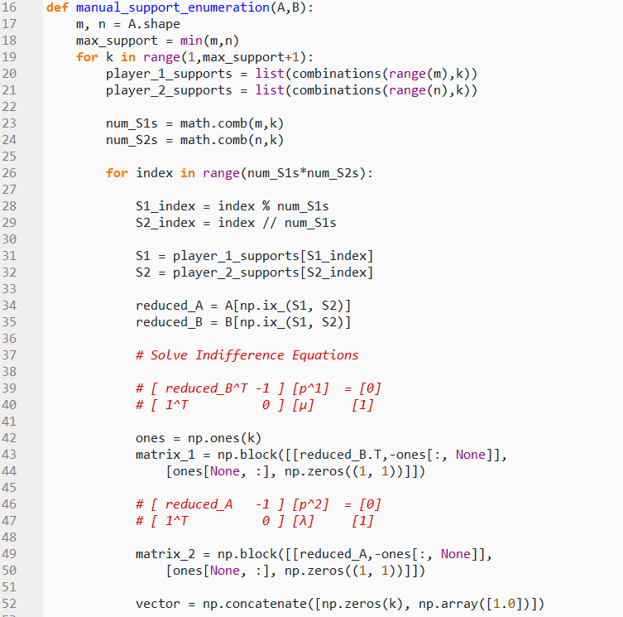
Manual Support Enumeration Function
As a proof of concept, I coded up a manual support enumeration program in Python
I’ve successfully tested it on a 4 x 5 zero sum game and a 2 x 3 non-zero sum game, in addition to our example
The code is included in Appendix A of this week’s latex write up

Slide 11
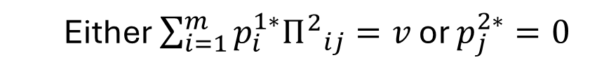
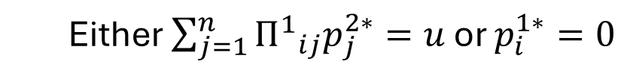
Vertex Enumeration Review
For non-degenerate, finite two player games, vertex enumeration obtains best response polytopes for both players and iterates through all possible pairs of vertices to obtain the Nash equilibrium
A pair of vertices correspond to a Nash equilibrium if they are fully labeled
Complementary Conditions for Fully Labeled Vertices
For all Player 1 strategies $i$ and Player 2 strategies $j$:
$\sum_{j=1}^{n}{{Π^{1}}_{ij}p_{j}^{2∗}≤u},\sum_{i=1}^{m}{p_{i}^{1∗}{Π^{2}}_{ij}≤v},p^{1∗}$and $p^{2∗}$ probability vectors
Either $\sum_{j=1}^{n}{{Π^{1}}_{ij}p_{j}^{2∗}=u}$ or $p_{i}^{1∗}=0$
Either $\sum_{i=1}^{m}{p_{i}^{1∗}{Π^{2}}_{ij}=v}$ or $p_{j}^{2∗}=0$
where $u,v$ correspond respectively to the equilibrium expected payoffs for Players 1 and 2
and $Π^{1},Π^{2}$correspond respectively to payoff matrices for Players 1 and 2

Slide 12
Vertex Enumeration Review
For non-degenerate, finite two player games, vertex enumeration obtains best response polytopes for both players and iterates through all possible pairs of vertices to obtain the Nash equilibrium
A pair of vertices correspond to a Nash equilibrium if they are fully labeled
Complementary Conditions for Fully Labeled Vertices
This is analogous to the Strong Minimax Theorem in zero sum games!
For all Player 1 strategies $i$ and Player 2 strategies $j$:
$\sum_{j=1}^{n}{{Π^{1}}_{ij}p_{j}^{2∗}≤u},\sum_{i=1}^{m}{p_{i}^{1∗}{Π^{2}}_{ij}≤v},p^{1∗}$and $p^{2∗}$ probability vectors
Either $\sum_{j=1}^{n}{{Π^{1}}_{ij}p_{j}^{2∗}=u}$ or $p_{i}^{1∗}=0$
Either $\sum_{i=1}^{m}{p_{i}^{1∗}{Π^{2}}_{ij}=v}$ or $p_{j}^{2∗}=0$
where $u,v$ correspond respectively to the equilibrium expected payoffs for Players 1 and 2
and $Π^{1},Π^{2}$correspond respectively to payoff matrices for Players 1 and 2

Slide 13
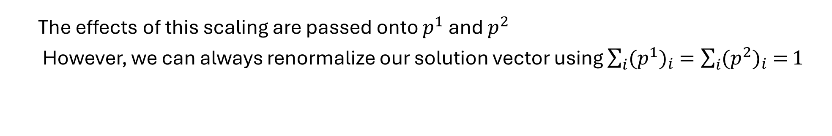

Best Response Polytopes
We use the first complementary conditions to generate the best response polytopes for Players 1 and 2, which we denote $P$ and $Q$
$P=\left\{p^{1}∈ℝ^{m} \right| {(Π^{2})}^{T}p^{1}≤v1, p^{1}$ is a probability vector$\}$
$Q=\left\{p^{2}∈ℝ^{n} \right| Π^{1}p^{2}≤u1, { p}^{2}$ is a probability vector$\}$
But what if we don’t know $u$ and $v$ beforehand??
The good news is that we actually don’t need to know them!
We can scale $u$ and $v$ down to $1$
The effects of this scaling are passed onto $p^{1}$ and $p^{2}$
However, we can always renormalize our solution vector using $\sum_{i}{{(p^{1})}_{i} =\sum_{i}{{(p^{2})}_{i} =}1}$

Slide 14
Best Response Polytopes
Our best response polytopes now become:
$$P=\left\{p^{1}∈ℝ^{m} \right| {(Π^{2})}^{T}p^{1}≤1, p^{1}≥0\}$$
$$Q=\left\{p^{2}∈ℝ^{n} \right| Π^{1}p^{2}≤1, { p}^{2}≥0\}$$

Slide 15







Best Response Polytopes
Consider the following example:
$$P=\left\{p^{1}∈ℝ^{m} \right| {(Π^{2})}^{T}p^{1}≤1, p^{1}≥0\}$$
20
Let $p^{1}=(x,y)$
30
3
6
-10
-2
-20
$P$ is the polytope bounded by:
-10
-4
20
5
4
$$6x−4y ≤1$$
$$−2x+5y≤1$$
$$3x+4y ≤1$$
$$x ≥0$$
$$y ≥0$$

Slide 16
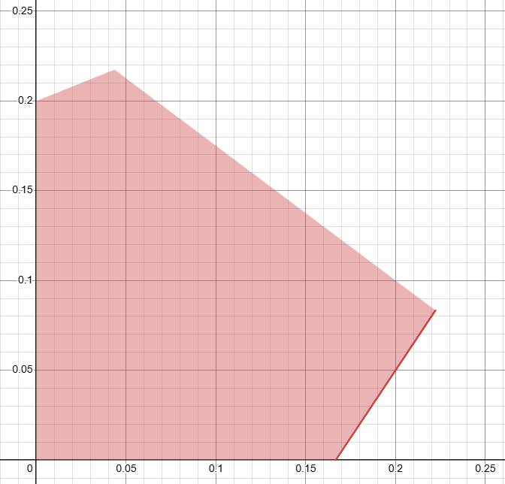



Best Response Polytopes
Consider the following example:
$$P=\left\{p^{1}∈ℝ^{m} \right| {(Π^{2})}^{T}p^{1}≤1, p^{1}≥0\}$$
20
Let $p^{1}=(x,y)$
30
3
6
-10
-2
$$y$$
-10
-20
-4
20
5
4
$$x$$

Slide 17


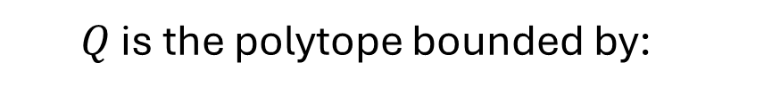

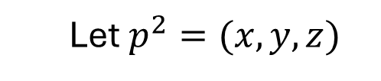


Best Response Polytopes
Consider the following example:
$$Q=\left\{p^{2}∈ℝ^{n} \right| Π^{1}p^{2}≤1, { p}^{2}≥0\}$$
20
Let $p^{2}=(x,y,z)$
30
3
6
-10
-2
-20
$Q$ is the polytope bounded by:
-10
-4
20
5
4
$$6x−2y+3z ≤1$$
$$−4x+5y+4z ≤1$$
$$x ≥0$$
$$y ≥0$$
$$z ≥0$$

Slide 18
Best Response Polytopes
Consider the following example:
$$Q=\left\{p^{2}∈ℝ^{n} \right| Π^{1}p^{2}≤1, { p}^{2}≥0\}$$
20
Q Polytope in Desmos
30
3
6
-10
-2
-10
-20
-4
20
5
4

Slide 19
Vertex Enumeration – How Do We Find Vertices?
Geometric Duality
A facet in primal space corresponds to a vertex in dual space
A facet in dual space corresponds to a vertex in primal space
Step 1: Find an interior point and define a new reference frame with this point at the origin
Step 2: Convert all facets in primal space to vertices in dual space
Step 3: Generate facets between the vertices in dual space
Step 4: Convert all facets in dual space to vertices in primal space
Step 5: Shift back to original reference frame

Slide 20
Converting Primal Facets into Dual Vertices
A primal facet can be written in the following form: $a^{T}x+b≤0$
The corresponding vertex in dual space is: $x= \frac{a}{−b}$
* We need a reference frame centered on an interior point so $b≠0$

Slide 21

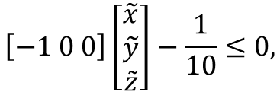
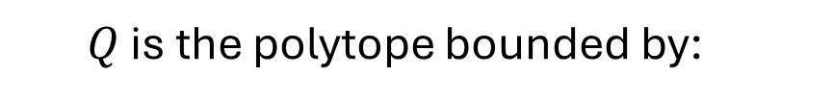

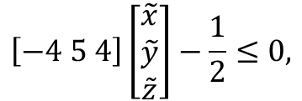
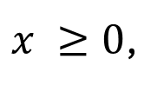
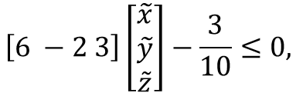

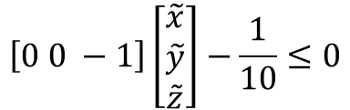
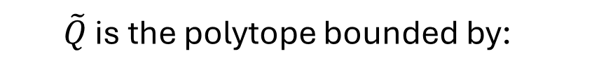

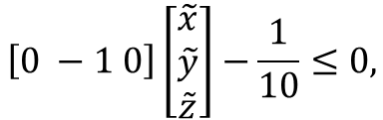
Vertex Enumeration – How Do We Find Vertices?
Example:
$Q$ is the polytope bounded by:
$$6x−2y+3z ≤1,$$
$$−4x+5y+4z ≤1,$$
$x ≥0$,
$$y ≥0,$$
$$z ≥0$$
Step 1: Shift frame of reference to $\tilde{x}=x−\frac{1}{10},\tilde{y}=y−\frac{1}{10},\tilde{z}=z−\frac{1}{10}$
$\tilde{Q}$ is the polytope bounded by:
$$\left[6 −2 3\right]\left[\begin{matrix}\tilde{x} \\ \tilde{y} \\ \tilde{z}\end{matrix}\right]−\frac{3}{10}≤0,$$
$$\left[−4 5 4\right]\left[\begin{matrix}\tilde{x} \\ \tilde{y} \\ \tilde{z}\end{matrix}\right]−\frac{1}{2}≤0,$$
$$\left[−1 0 0\right]\left[\begin{matrix}\tilde{x} \\ \tilde{y} \\ \tilde{z}\end{matrix}\right]−\frac{1}{10}≤0,$$
$$\left[0 −1 0\right]\left[\begin{matrix}\tilde{x} \\ \tilde{y} \\ \tilde{z}\end{matrix}\right]−\frac{1}{10}≤0,$$
$$\left[0 0 −1\right]\left[\begin{matrix}\tilde{x} \\ \tilde{y} \\ \tilde{z}\end{matrix}\right]−\frac{1}{10}≤0$$
Step 2: Convert all facets in primal space to vertices in dual space
We get the following vertices in dual space: $\left[20 −\frac{20}{3} 10\right],\left[−8 10 8\right],\left[−10 0 0\right],\left[0 −10 0\right],\left[0 0 −10\right]$

Slide 22
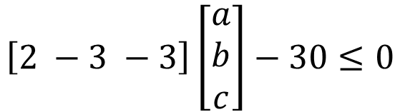
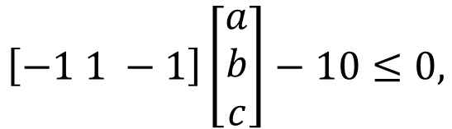
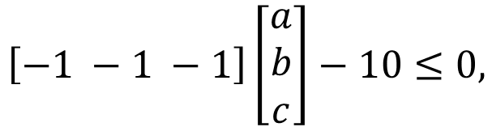
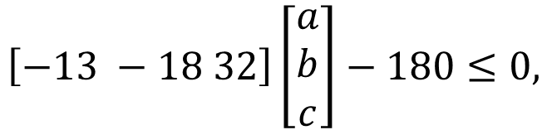
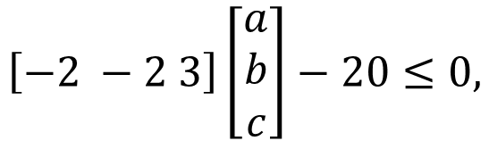
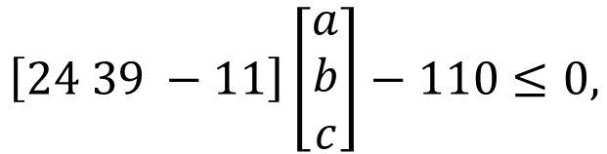
Vertex Enumeration – How Do We Find Vertices?
Example:
Step 3: Generate facets between the vertices in dual space
$$\left[−1 1 −1\right]\left[\begin{matrix}a \\ b \\ c\end{matrix}\right]−10≤0,$$
$$\left[24 39 −11\right]\left[\begin{matrix}a \\ b \\ c\end{matrix}\right]−110≤0,$$
$$\left[−2 −2 3\right]\left[\begin{matrix}a \\ b \\ c\end{matrix}\right]−20≤0,$$
$$\left[−13 −18 32\right]\left[\begin{matrix}a \\ b \\ c\end{matrix}\right]−180≤0,$$
$$\left[−1 −1 −1\right]\left[\begin{matrix}a \\ b \\ c\end{matrix}\right]−10≤0,$$
$$\left[2 −3 −3\right]\left[\begin{matrix}a \\ b \\ c\end{matrix}\right]−30≤0$$
Step 4: Convert all facets in dual space to vertices in primal space
We get the following vertices in primal space:
$\left[\frac{−1}{10} \frac{1}{10} \frac{−1}{10}\right],\left[\frac{24}{110} \frac{39}{110} \frac{−1}{10}\right],\left[\frac{−1}{10} \frac{−1}{10} \frac{3}{20}\right],\left[\frac{−13}{180} \frac{−1}{10} \frac{8}{45}\right],\left[\frac{−1}{10} \frac{−1}{10} \frac{−1}{10}\right],\left[\frac{1}{15} \frac{−1}{10} \frac{−1}{10}\right]$

Slide 23
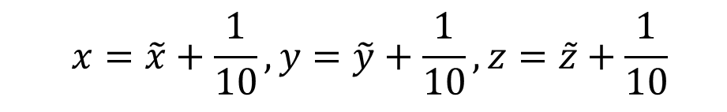
Vertex Enumeration – How Do We Find Vertices?
Example:
Step 5: Shift back to original reference frame
$$\left[\frac{−1}{10} \frac{1}{10} \frac{−1}{10}\right],\left[\frac{24}{110} \frac{39}{110} \frac{−1}{10}\right],\left[\frac{−1}{10} \frac{−1}{10} \frac{3}{20}\right],\left[\frac{−13}{180} \frac{−1}{10} \frac{8}{45}\right],\left[\frac{−1}{10} \frac{−1}{10} \frac{−1}{10}\right],\left[\frac{1}{15} \frac{−1}{10} \frac{−1}{10}\right]$$
$$x=\tilde{x}+\frac{1}{10},y=\tilde{y}+\frac{1}{10},z=\tilde{z}+\frac{1}{10}$$
$$\left[0 \frac{1}{5} 0\right],\left[\frac{7}{22} \frac{5}{11} 0\right],\left[0 0\frac{1}{4}\right],\left[\frac{1}{36} 0 \frac{5}{18}\right],\left[0 0 0\right],\left[\frac{1}{6} 0 0\right]$$

Slide 24
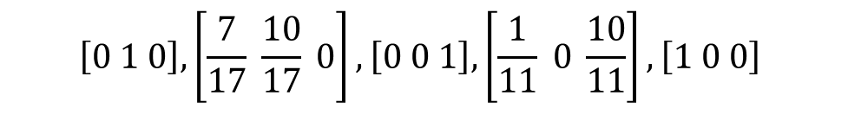

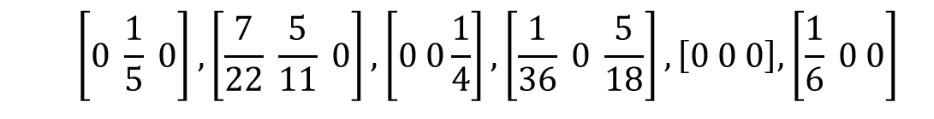
Continuing the Example
Example:
Now we re-normalize our probability vectors:
$$\left[0 \frac{1}{5} 0\right],\left[\frac{7}{22} \frac{5}{11} 0\right],\left[0 0\frac{1}{4}\right],\left[\frac{1}{36} 0 \frac{5}{18}\right],\left[0 0 0\right],\left[\frac{1}{6} 0 0\right]$$
$$\left[0 1 0\right],\left[\frac{7}{17} \frac{10}{17} 0\right],\left[0 0 1\right],\left[\frac{1}{11} 0 \frac{10}{11}\right],\left[1 0 0\right]$$
$$\left[1 0 0\right]$$
$$\left[0 1 0\right]$$
$$\left[0 0 1\right]$$
$$\left[\frac{7}{17} \frac{10}{17} 0\right]$$
$$\left[\frac{1}{11} 0 \frac{10}{11}\right]$$
Equilibrium vector with Player 2 Support {A}
Equilibrium vector with Player 2 Support {B}
20
30
3
6
-10
-2
Equilibrium vector with Player 2 Support {C}
-10
-20
-4
20
5
4
Equilibrium vector with Player 2 Support {A,B}
Equilibrium vector with Player 2 Support {A,C}

Slide 25
Continuing the Example
Example:
Now we re-normalize our probability vectors:
$$\left[0 \frac{1}{5} 0\right],\left[\frac{7}{22} \frac{5}{11} 0\right],\left[0 0\frac{1}{4}\right],\left[\frac{1}{36} 0 \frac{5}{18}\right],\left[0 0 0\right],\left[\frac{1}{6} 0 0\right]$$
$$\left[0 1 0\right],\left[\frac{7}{17} \frac{10}{17} 0\right],\left[0 0 1\right],\left[\frac{1}{11} 0 \frac{10}{11}\right],\left[1 0 0\right]$$
$$\left[1 0 0\right]$$
$$\left[0 1 0\right]$$
$$\left[0 0 1\right]$$
$$\left[\frac{7}{17} \frac{10}{17} 0\right]$$
$$\left[\frac{1}{11} 0 \frac{10}{11}\right]$$
Equilibrium vector with Player 2 Support {A}
Equilibrium vector with Player 2 Support {B}
Player 2’s Nash Equilibrium Strategy
20
30
3
6
-10
-2
Equilibrium vector with Player 2 Support {C}
-10
-20
-4
20
5
4
Equilibrium vector with Player 2 Support {A,B}
Equilibrium vector with Player 2 Support {A,C}

Slide 26
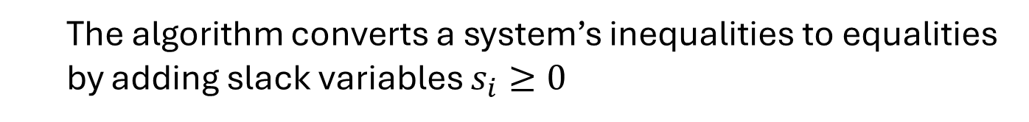
Simplex Algorithm
The Simplex Algorithm is an pivot-based method for solving linear problems. It starts at a vertex and pivots along edges to adjacent vertices that improve the objective value
The algorithm converts a system’s inequalities to equalities by adding slack variables $s_{i}≥0$
We can then rewrite our objective function in terms of “non-basic variables” [equal to 0 at that vertex]
If increasing a non-basic variable improves our objective value, we move to the vertex where that non-basic variable is maximized
The Simplex Algorithm is designed for optimization on the surface of only one polytope, not for vertex enumeration across two polytopes

Slide 27
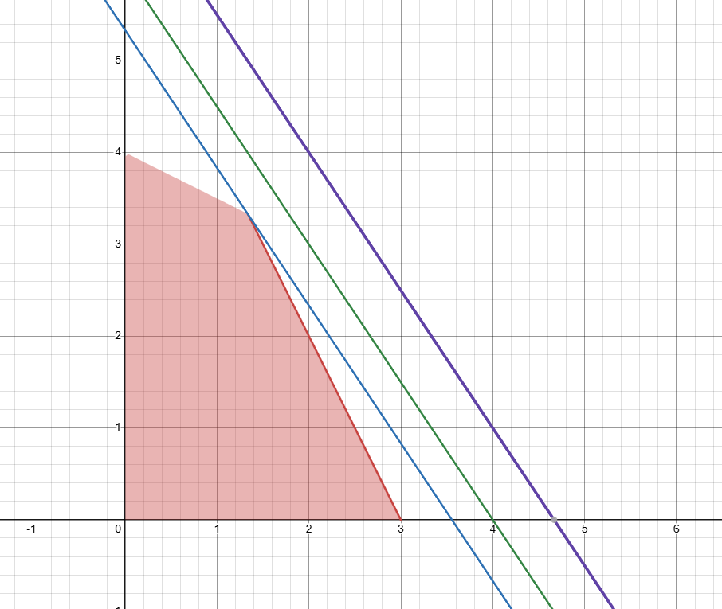
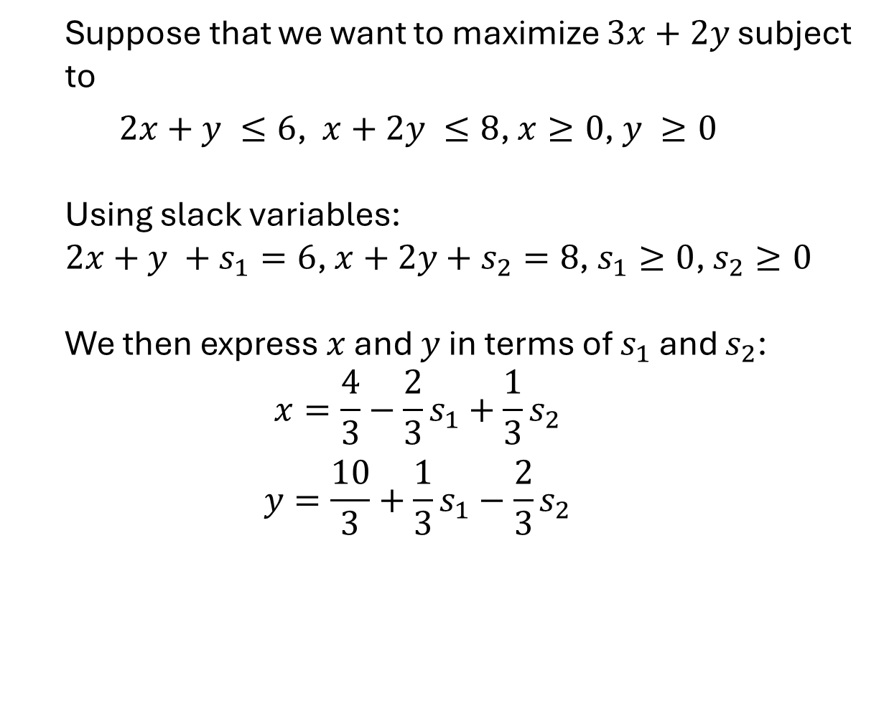


Simplex Algorithm
Example:
Suppose that we want to maximize $3x+2y$ subject to
$2x+y ≤6$, $x+2y ≤8$, $x≥0$, $y ≥0$
Using slack variables:
$2x+y +s_{1}=6$, $x+2y+s_{2}=8$, $s_{1}≥0$, $s_{2}≥0$
We then express $x$ and $y$ in terms of $s_{1}$ and $s_{2}$:
$$x=\frac{4}{3}−\frac{2}{3}s_{1}+\frac{1}{3}s_{2}$$
$$y=\frac{10}{3}+\frac{1}{3}s_{1}−\frac{2}{3}s_{2}$$
$$y$$
Lines of Constant Utility
$$x$$

Slide 28
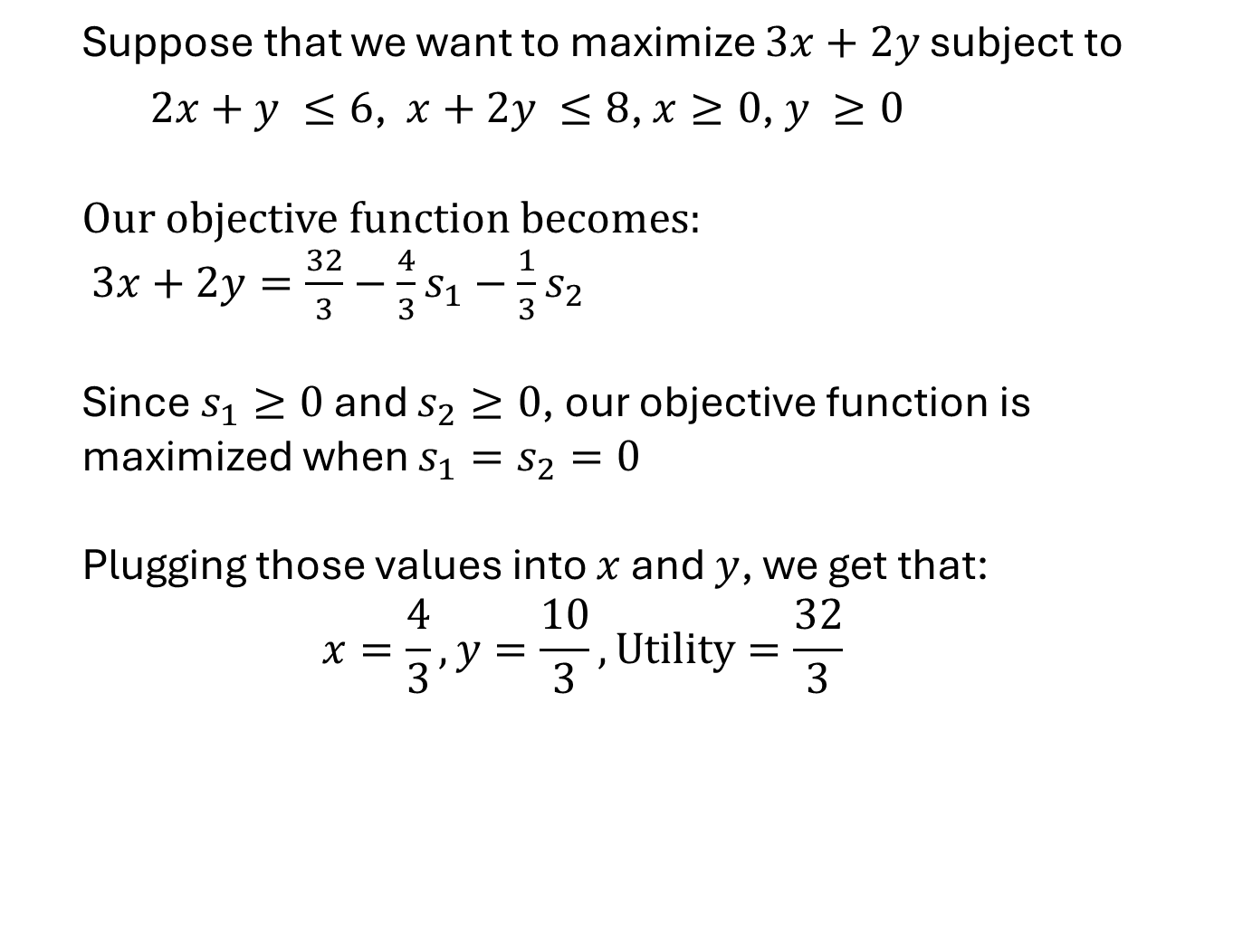
Simplex Algorithm
Example:
Suppose that we want to maximize $3x+2y$ subject to
$2x+y ≤6$, $x+2y ≤8$, $x≥0$, $y ≥0$
Our objective function becomes:
$3x+2y=\frac{32}{3}−\frac{4}{3}s_{1}−\frac{1}{3}s_{2}$
Since $s_{1}≥0$ and $s_{2}≥0$, our objective function is maximized when $s_{1}=s_{2}=0$
Plugging those values into $x$ and $y$, we get that:
$$x=\frac{4}{3}, y=\frac{10}{3}, Utility=\frac{32}{3}$$
Lines of Constant Utility

Slide 29
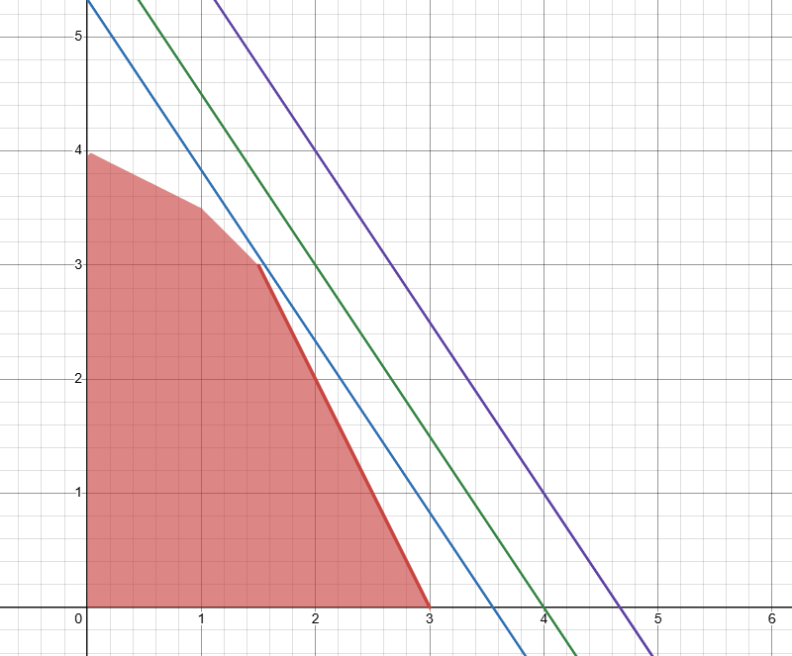
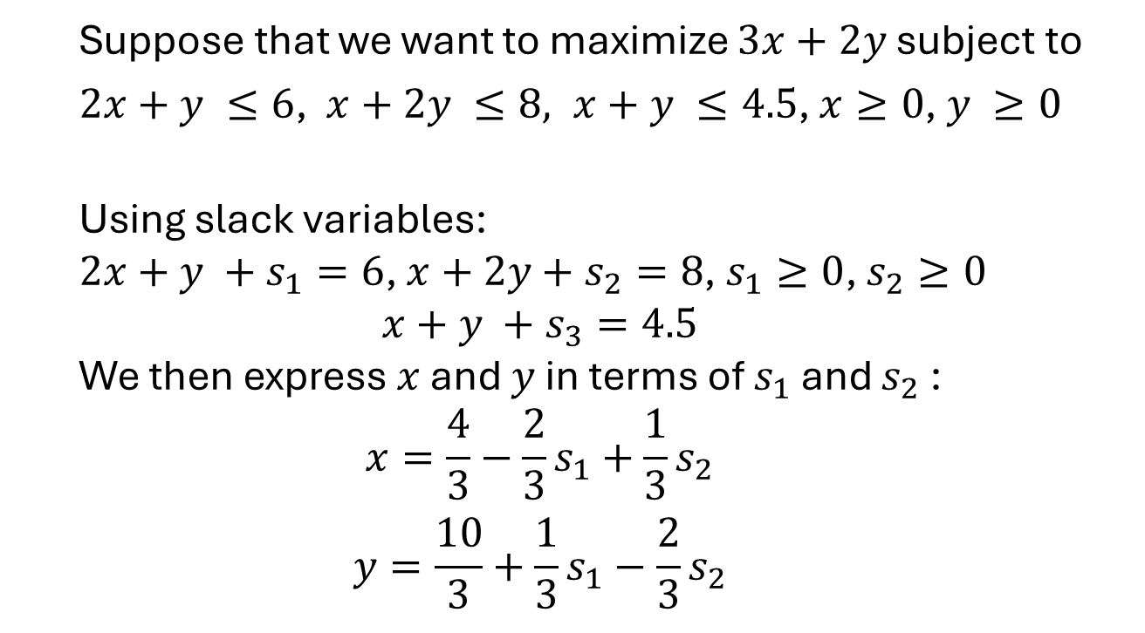
Simplex Algorithm
Example 2.0:
Suppose that we want to maximize $3x+2y$ subject to
$2x+y ≤6$, $x+2y ≤8, x+y ≤4.5$, $x≥0$, $y ≥0$
Using slack variables:
$2x+y +s_{1}=6$, $x+2y+s_{2}=8$, $s_{1}≥0$, $s_{2}≥0$
$$x+y +s_{3}=4.5$$
We then express $x$ and $y$ in terms of $s_{1}$ and $s_{2}$:
$$x=\frac{4}{3}−\frac{2}{3}s_{1}+\frac{1}{3}s_{2}$$
$$y=\frac{10}{3}+\frac{1}{3}s_{1}−\frac{2}{3}s_{2}$$
$$y$$
Lines of Constant Utility
$$x$$

Slide 30

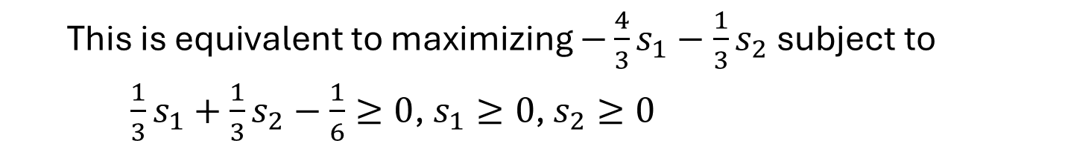


Simplex Algorithm
Example:
Our objective function becomes:
$$3x+2y=\frac{32}{3}−\frac{4}{3}s_{1}−\frac{1}{3}s_{2}$$
Note that $s_{3}=$ $\frac{1}{3}s_{1}+ \frac{1}{3}s_{2}−\frac{1}{6}$
Now we want to maximize $−\frac{4}{3}s_{1}−\frac{1}{3}s_{2}$subject to
$s_{3}=$ $\frac{1}{3}s_{1}+\frac{1}{3}s_{2}−\frac{1}{6}$, $s_{1}≥0$, $s_{2}≥0,s_{3}≥0$
This is equivalent to maximizing $−\frac{4}{3}s_{1}−\frac{1}{3}s_{2}$subject to
$\frac{1}{3}s_{1}+\frac{1}{3}s_{2}−\frac{1}{6}≥0$, $s_{1}≥0$, $s_{2}≥0$
This maximization occurs when $s_{1}=0$, $s_{2}=\frac{1}{2}$
Plugging those values into $x$ and $y$, we get that: $x=\frac{3}{2}, y=3, Utility=\frac{21}{2}$

